Slide 1
Dependable Distributed Systems
Master of Science in Engineering in Computer Science
AA 2026/2027
Lectures 14: Software Replication

Slide 2
Motivation
Fault Tolerance
  Guarantee the availability of a service (also called object) despite failures
Assuming p the failure probability of an object O. O’s availability is 1-p.
  Replicating an object O on n nodes and assuming p the failure probability of each replica, O’s availability is 1- p^{n} (considering independent failures probability)

Slide 3
System Model
The system is composed of a set of processes (clients)
  Processes are connected through Perfect point-to-point links
  Processes may fail by crash
Processes interacts wit a set of objects X located at different sites managed managed by processes
  Each object has a state accessed trough a set of operations
  An operation by a process p_{i} on an object x ∈ X is a pair invocation/response
    The operation invocation is noted [x op(arg) p_{i}] where arg are the arguments of the operation op
    The operation response is noted [x ok(res) p_{i}] where res is the result returned
    The pair invocation/response is noted [x op(arg)/ok(res) p_{i}]
  After issuing an invocation a process is blocked until it receives the matching response

Slide 4
Replication: requirements
In order to tolerate process crash failures a logical object must have several physical replicas located at different sites of the distributed system
  replicas of an object x are noted x¹, x², … x^{l}
  Invocation of replica x^{j} located on site s is handled by a process p_{j} also located on s
  We assume that p_{j} crashes exactly when x^{j} crashes
Replication is transparent to the client processes

Slide 5
Consistency criteria
A consistency criterion defines the result returned by an operation
  It can be seen as a contract between the programmer and the system implementing replication
Three main consistency criteria are defined in literature
  Linearizability
  Sequential consistency
  Causal consistency
The three consistency criteria differ however in the definition of the most recent state
Strong Consistency
Weak Consistency

Slide 6
Linearizability
Let us consider the precedence relation ( denoted ≺) and the concurrency relation (denoted ||) defined between two operations.
An execution E is linearizable if there exists a sequence S including all operations of E such that the following two conditions hold:
  for any two operations O₁ and O₂ such that O₁ ≺ O₂, O₁ appears before O₂ in the sequence S
  the sequence S is legal i.e., for every object x the subsequence of S of which operations are on x belongs to the sequential specification of x.

Slide 7
Example: simple variable
LINEARIZZABILE
x write(a) p₁ ok()
x read() p₁ ok(b)
p₁
p₂
x write(b) p₂ ok()
NON LINEARIZZABILE
p₁
x write(a) p₁ ok()
x read() p₁ ok(a)
p₂
x write(b) p₂ ok()

Slide 8
Example: FIFO Queue
x enq(a) p_{i}
x ok() p_{i}
x deq() p_{i}
x ok(b) p_{i}
O₁
O₃
x enq(b) p_{j}
x ok() p_{j}
x deq() p_{j}
x ok(a) p_{j}
O₂
O₄
Linearizable
S= {O2, O1, O3, O4}

Slide 9
Example: FIFO Queue
x enq(a) p_{i}
x ok() p_{i}
x deq() p_{i}
x ok(b) p_{i}
Not Legal wrt the sequential specification of a FIFO queue
O₁
O₃
x enq(b) p_{j}
x ok() p_{j}
x deq() p_{j}
x ok(b) p_{j}
O₂
O₄
NON-Linearizable

Slide 10
A Sufficient Condition for Linearizability
Replicas must agree on the set of invocations they handle and on the order according to which they handle these invocations
Atomicity: Given an invocation [x op(arg) p_{i}], if one replica of the object x handles this invocation, then every correct replica of x also handles the invocation [x op(arg) p_{i}].
Ordering: Given two invocations [x op(arg) p_{i}] and [x op(arg) p_{j}] if two replicas handle both the invocations, they handle them in the same order

Slide 11
Replication Techniques
Two main techniques implementing linearizability:
  Primary Backup
  Active Replication

Slide 12
Passive Replication
Primary-Backup

Slide 13
Primary Backup
  Primary:
    Receives invocations from clients and sends back the answers.
    Given an object x, prim(x) returns the primary of x.
  Backup:
    Interacts with prim(x)
    is used to guarantee fault tolerance by replacing a primary when crashes

Slide 14
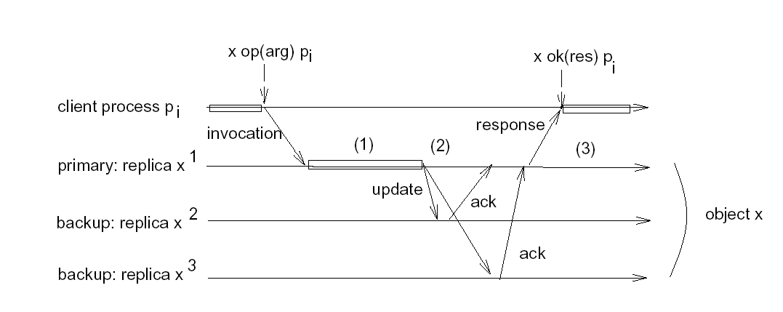
Primary Backup Scenario

Slide 15
Primary Backup: the case of no crash
When update messages are received by backups, they update their state and send back the ack to prim(x).
prim(x) waits for an ack message from each correct backup and then sends back the answer, res, to the client.
How to guarantee Linearizability: the order in which prim(x) receive clients’ invocations define the order of the operation on the object.

Slide 16
Primary Backup:
Presence of Crash
Three scenarios :
Scenario 1: Primary fails after the client receives the answer.
Scenario 2: Primary fails before sending update messages
Scenario 3: Primary fails after sending update messages and before receiving all the ack messages.
In all cases there is the need of electing a new leader.

Slide 17
Scenario 1
Primary fails after sending the answer
Two cases
  Client does not receive the response due to perfect point-to-point link. If the response is lost, client retransmits the request after a timeout
  Client receives the answer, everybody is happy (but the primary ☺)
The new primary will recognize the request re-issued by the client as already processed and sends back the result without updating the replicas

Slide 18
Scenario 2
Primary fails before sending update messages
Client does not get an answer and resends the requests after a timeout
The new primary will handle the request as new

Slide 19
Scenario 3
Primary fails after sending update messages and before receiving all the ack messages
How to Guarantee atomicity? update it is received either by all or by no one.
When a primary fails there is the need to elect another primary among the correct replicas

Slide 20
Active Replication

Slide 21
Active Replication
There is no coordinator all replicas have the same role
Each replica is deterministic. If any replica starts from the same state and receives the same input, they will produce the same output
As a matter of fact clients will receive the same response one from each replica

Slide 22
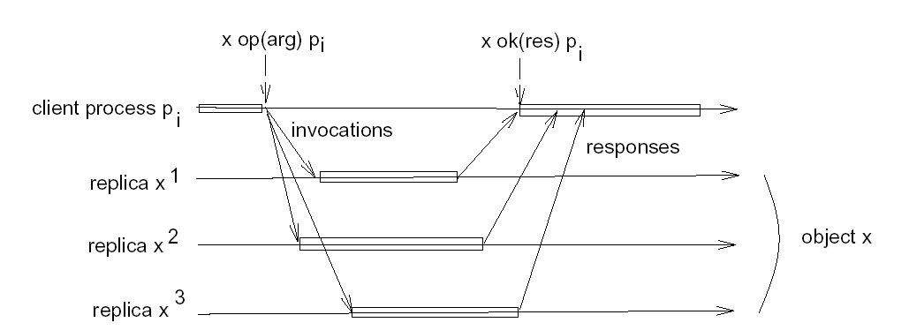
Active Replication

Slide 23
Active Replication
How to Guarantee Linearizability
To ensure linearlizability we need to preserve:
  Atomicity: if a replica executes an invocation, all correct replicas execute the same invocation.
  Ordering: (at least) no two correct replicas have to execute two invocations in different order.
We need: TOTAL ORDER Broadcast
  INCLUDING THE CLIENTS!

Slide 24
Active Replication
Crash
Active Replication does not need recovery action upon the failure of a replica

Slide 25
References
Rachid Guerraoui and André Schiper: “Fault-Tolerance by Replication in Distributed Systems”. In Proceedings of the 1996 Ada-Europe International Conference on Reliable Software Technologies (Ada-Europe '96).

